Slide 1
A Programming Career for Everybody
Navigating the path to mastery
Dr. Charles Severance
University of Michigan School of Information

Slide 2
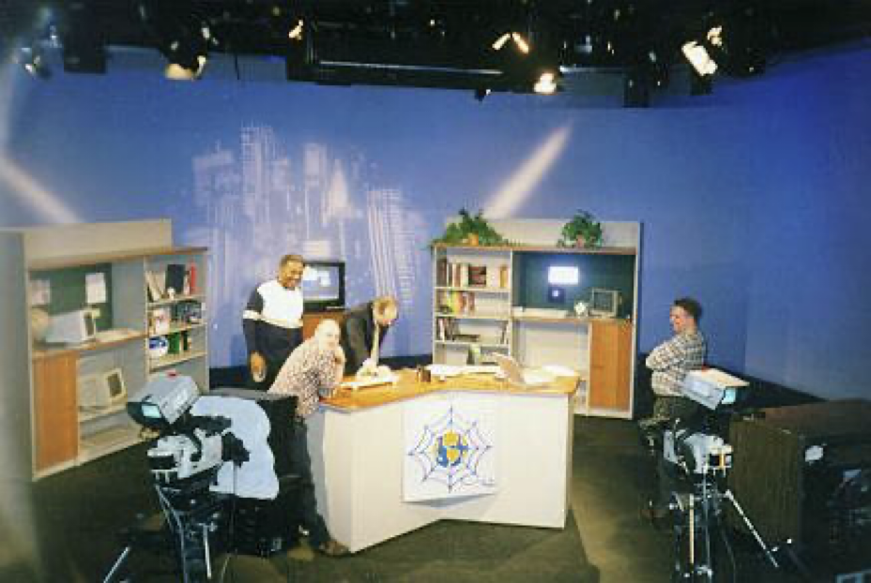
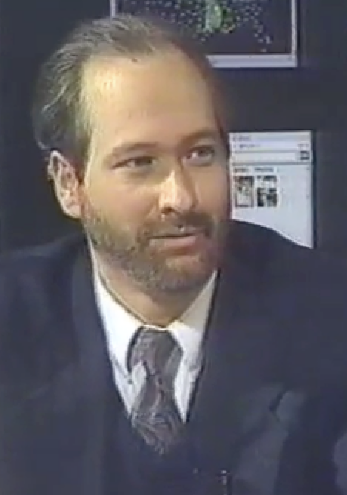
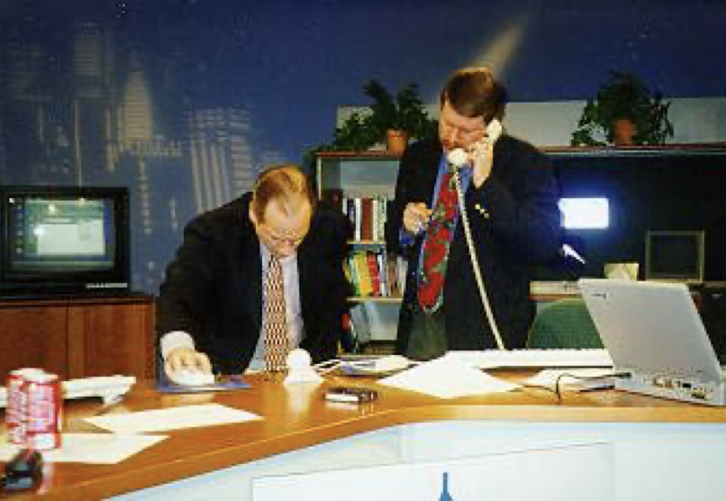
TV "Personality"
Sponsored and distributed by Cable television networks
East Lansing, MI
Promote Cable Modems
Internet:TCI (1996-97)
Nuthin' but Net (1998-99)
Pre-Internet Influencer

Slide 3
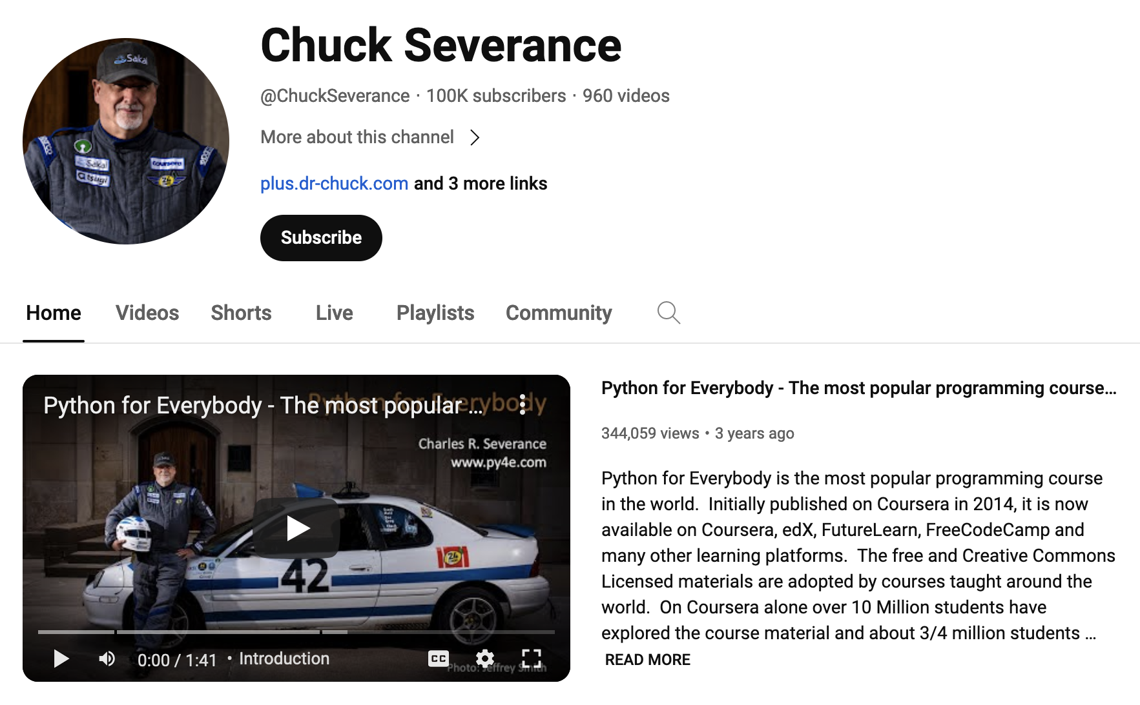
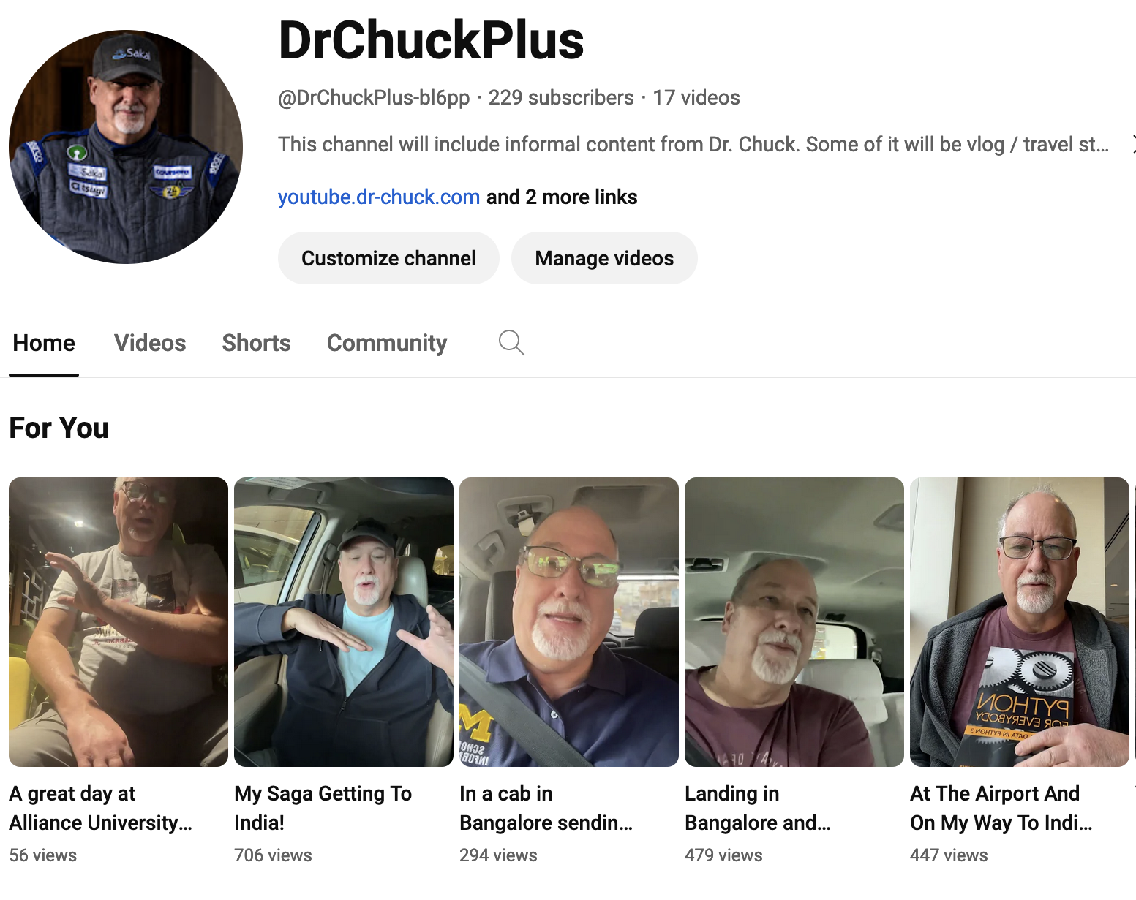
plus.dr-chuck.com
youtube.dr-chuck.com

Slide 4
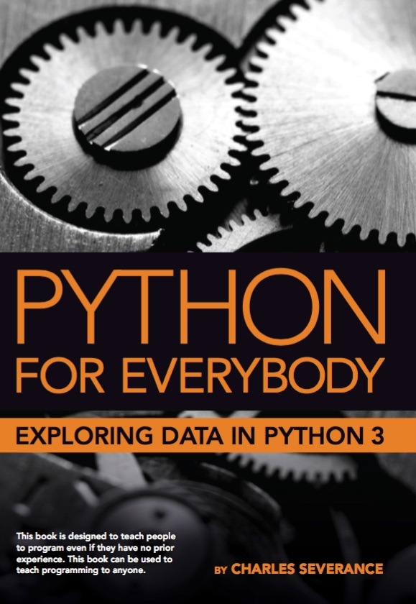
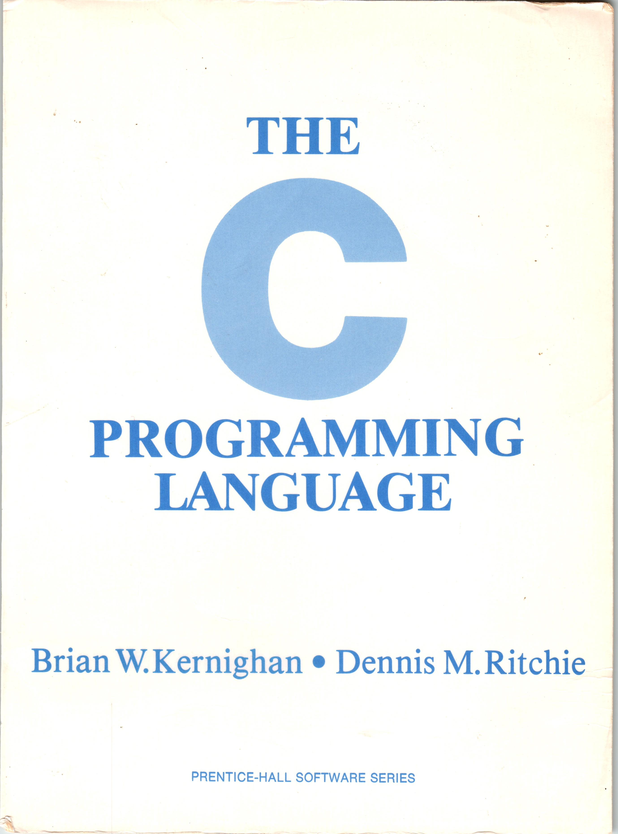
A Tale of Two Books, 10 years, and Coursera
Coursera: Python for Everybody (2013)
Coursera: C Programming for Everybody (2023)

Slide 5
Who is "Everybody"?
Pre-college students preparing for college
College students taking a challenging course
Working adults that want to take the next step in their career
Older adults with free time and want to "see if they can do it"
Successful people that want to try "something else"

Slide 6
Coursera: Python for Everybody
Introduced in 2013, Updated 2016, 2024
The most popular programming course in the world
Translated into 10+ Languages
In browser development environment
Many auto-graded exercises
Extra – more than just a course
Interviews
Office Hours

Slide 7
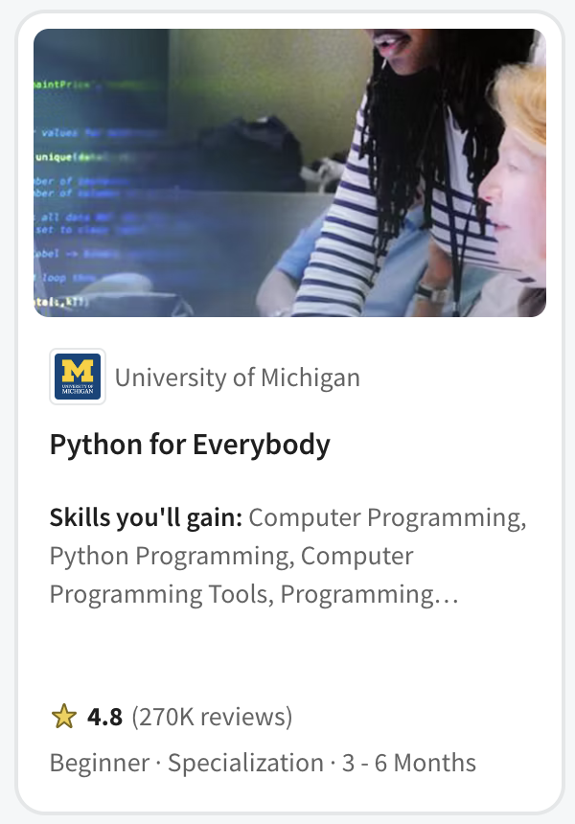
PY4E (2013)
Not a first course in Computer Science
Programing for Librarians
Quickly became the pre-requisite for
John Hopkins Data Science
Rice University Interactive Python
University of Michigan Python 3
University of Michigan Statistics with Python
University of Michigan Applied Data Science with Python
University of Michigan Masters of Applied Data Science
Popular in Coursera for Campus - India

Slide 8
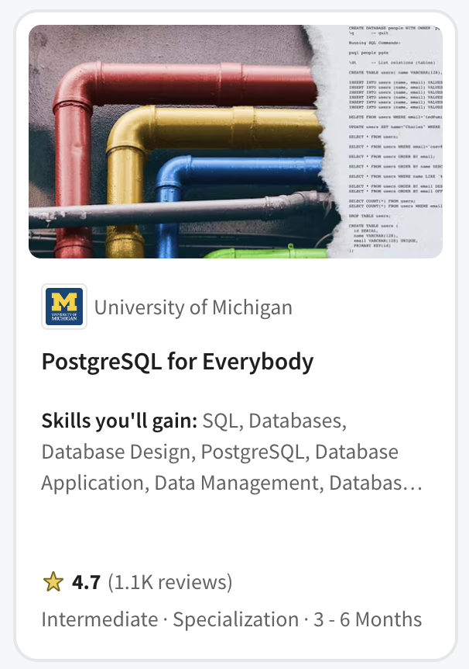
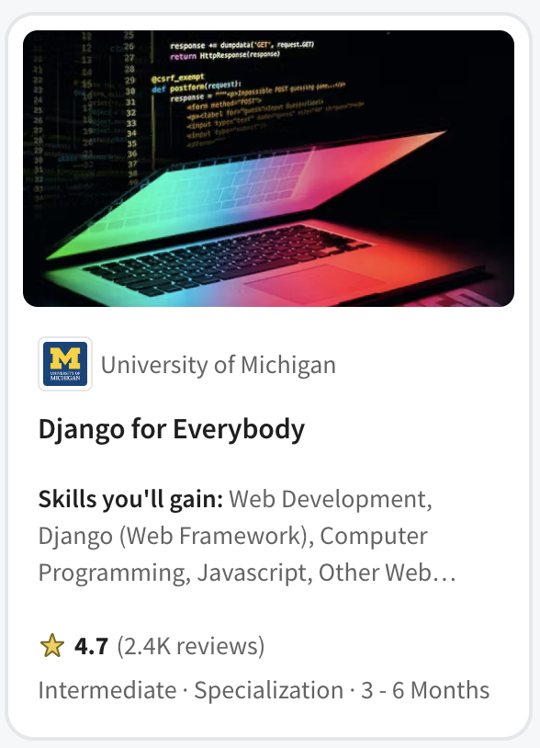

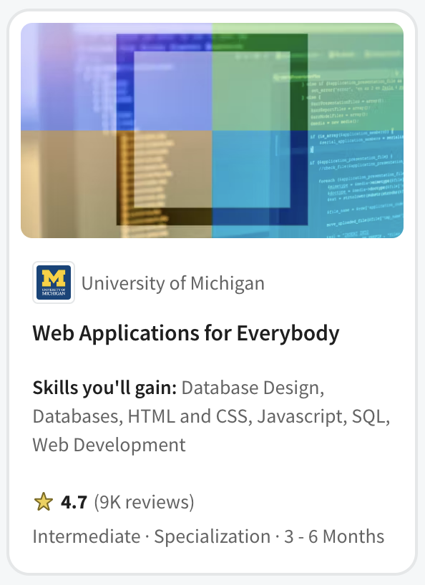

Slide 9

Every week 1400 new students enroll in Python for Everybody in India

Slide 10

Introductory Programming
Ready to Work

Slide 11

Who would I hire?
I have met many amazing developers
Not the most educated
Not the most brilliant minds
Learned through working on large complex projects
Love to help other people learn

Slide 12
It is not what they know…
Flask
SpringMVC
RedShift
BigData
Rust
Java
C#
Scala
JavaScript
HTML
Go
C++
VB
Fortran
AI
Kotlin
Node
PHP
C
React
JQuery
Perl
Dart
Backbone
Angular
R
ObjectiveC
Svelte
Lua
Ruby
COBOL
Django
SQL
Assembly
Swift
Python
Jupyter

Slide 13

It is how they learn
Can learn any programming situation and master it in four weeks
See past the syntax (X-ray Vision)
Run-time environments and internal data structures memory use, performance tradeoff

Slide 14
Flask
SpringMVC
Rust
RedShift
BigData
Java
C#
Scala
JavaScript
HTML
Go
C++
VB
Fortran
AI
Kotlin
PHP
Node
JQuery
Perl
C
React
Dart
Backbone
R
ObjectiveC
Angular
Svelte
Lua
Ruby
COBOL
Django
SQL
Assembly
Swift
Python
Jupyter

Slide 15
Flask
SpringMVC
RedShift
BigData
Rust
Java
C#
Scala
JavaScript
HTML
Go
C++
VB
Fortran
AI
Kotlin
Node
PHP
C
React
JQuery
Perl
Dart
Backbone
Angular
R
ObjectiveC
Svelte
Lua
Ruby
COBOL
Django
SQL
Assembly
Swift
Python
Jupyter
???
???
???
???

Slide 16
Flask
SpringMVC
RedShift
BigData
Rust
Java
C#
Scala
JavaScript
HTML
Go
C++
VB
Fortran
AI
Kotlin
Node
PHP
C
React
JQuery
Perl
Dart
Backbone
Angular
R
ObjectiveC
Svelte
Lua
Ruby
COBOL
Django
SQL
Assembly
Swift
Jupyter
Python
???
???
???

Slide 17
Flask
SpringMVC
RedShift
BigData
Rust
Java
C#
Scala
JavaScript
HTML
Go
C++
VB
Fortran
AI
Kotlin
Node
PHP
React
JQuery
Perl
Dart
Backbone
Angular
R
ObjectiveC
Svelte
Lua
Ruby
COBOL
Django
Swift
Jupyter
Python
C
Architecture
Assembly
SQL

Slide 18
Flask
Rust
SpringMVC
RedShift
BigData
Java
C#
Scala
HTML
JavaScript
Go
C++
VB
Fortran
AI
Kotlin
Node
PHP
Perl
React
JQuery
Dart
Backbone
R
ObjectiveC
Angular
Svelte
COBOL
Django
Lua
Ruby
Swift
Jupyter
???
???
???
Python
C
Architecture
Assembly
SQL

Slide 19
Flask
SpringMVC
BigData
Rust
RedShift
Scala
C#
Fortran
Go
C++
VB
AI
Kotlin
PHP
React
Node
JQuery
Perl
Dart
Backbone
R
ObjectiveC
Angular
Svelte
Lua
Ruby
COBOL
Django
Swift
Jupyter
HTML
JavaScript
Java
Python
C
Architecture
Assembly
SQL

Slide 20
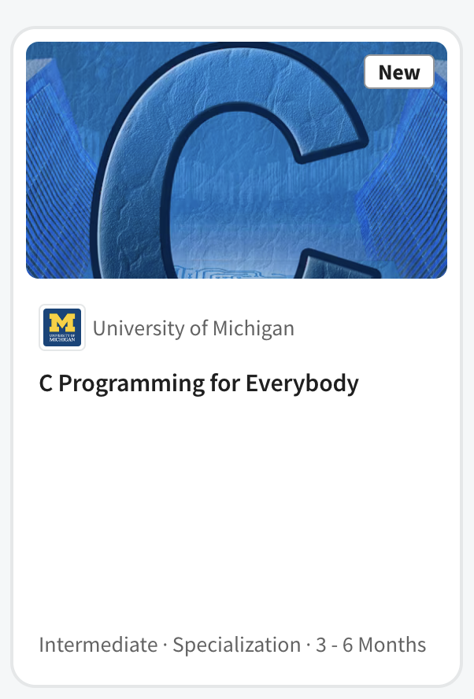

Slide 21

Unlocking a deeper understanding of Python by teaching C

Slide 22
My goals for students (not the course outline)
Understand C through a Python lens and Python through a C lens
Understand the nature of object-oriented programming
Understand interfaces
Different implementations behind an abstraction
Explain the how Python was built in C and inspired by C++
Have a sense of how the Python run time manages its objects and uses memory
See historical connections between C, C++, Python, Java, and JavaScript

Slide 23
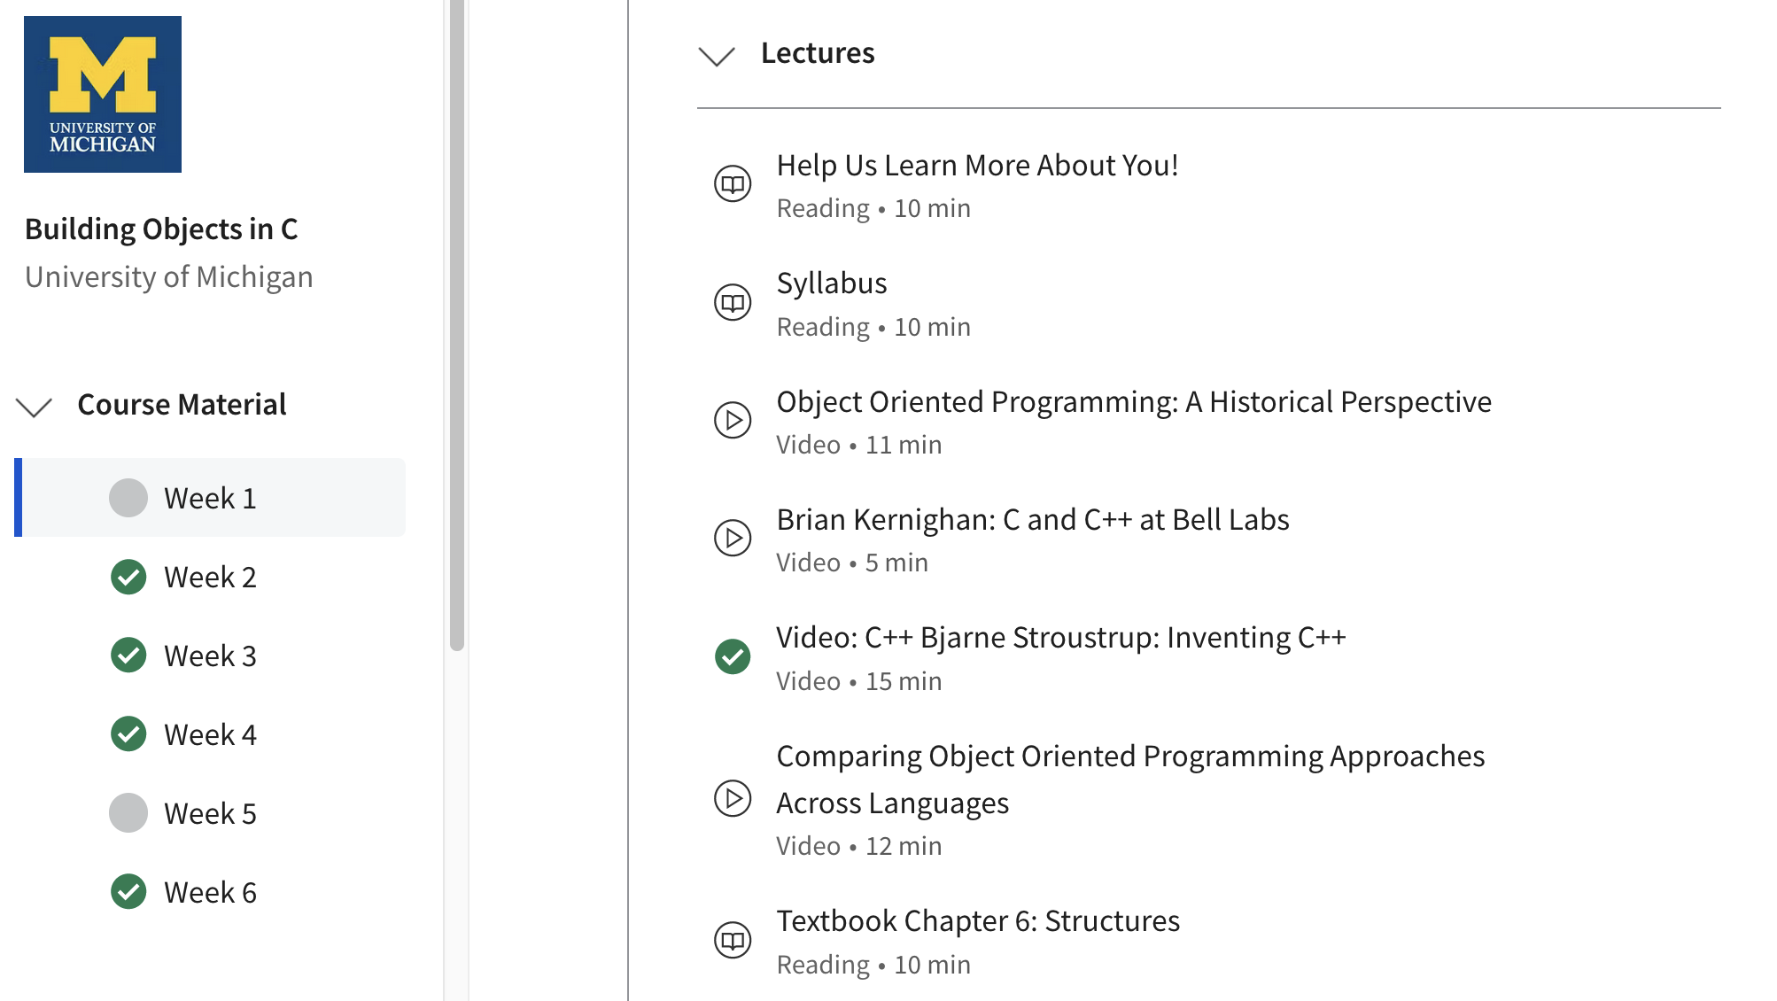

Slide 24


C Programming for Everybody
Uses 1978 edition of book to focus on historical impact of C
Online textbook with executable examples
Accessible audio book including code samples
Starts by comparing Python to C (Rosetta Stone)
48 Auto-graded assignments
Brower-based development and compiler environment
Ends with building Python objects in C
Extras
Interviews: Brian Kernighan, Bjarne Stroustrup, Guido van Rossum

Slide 25
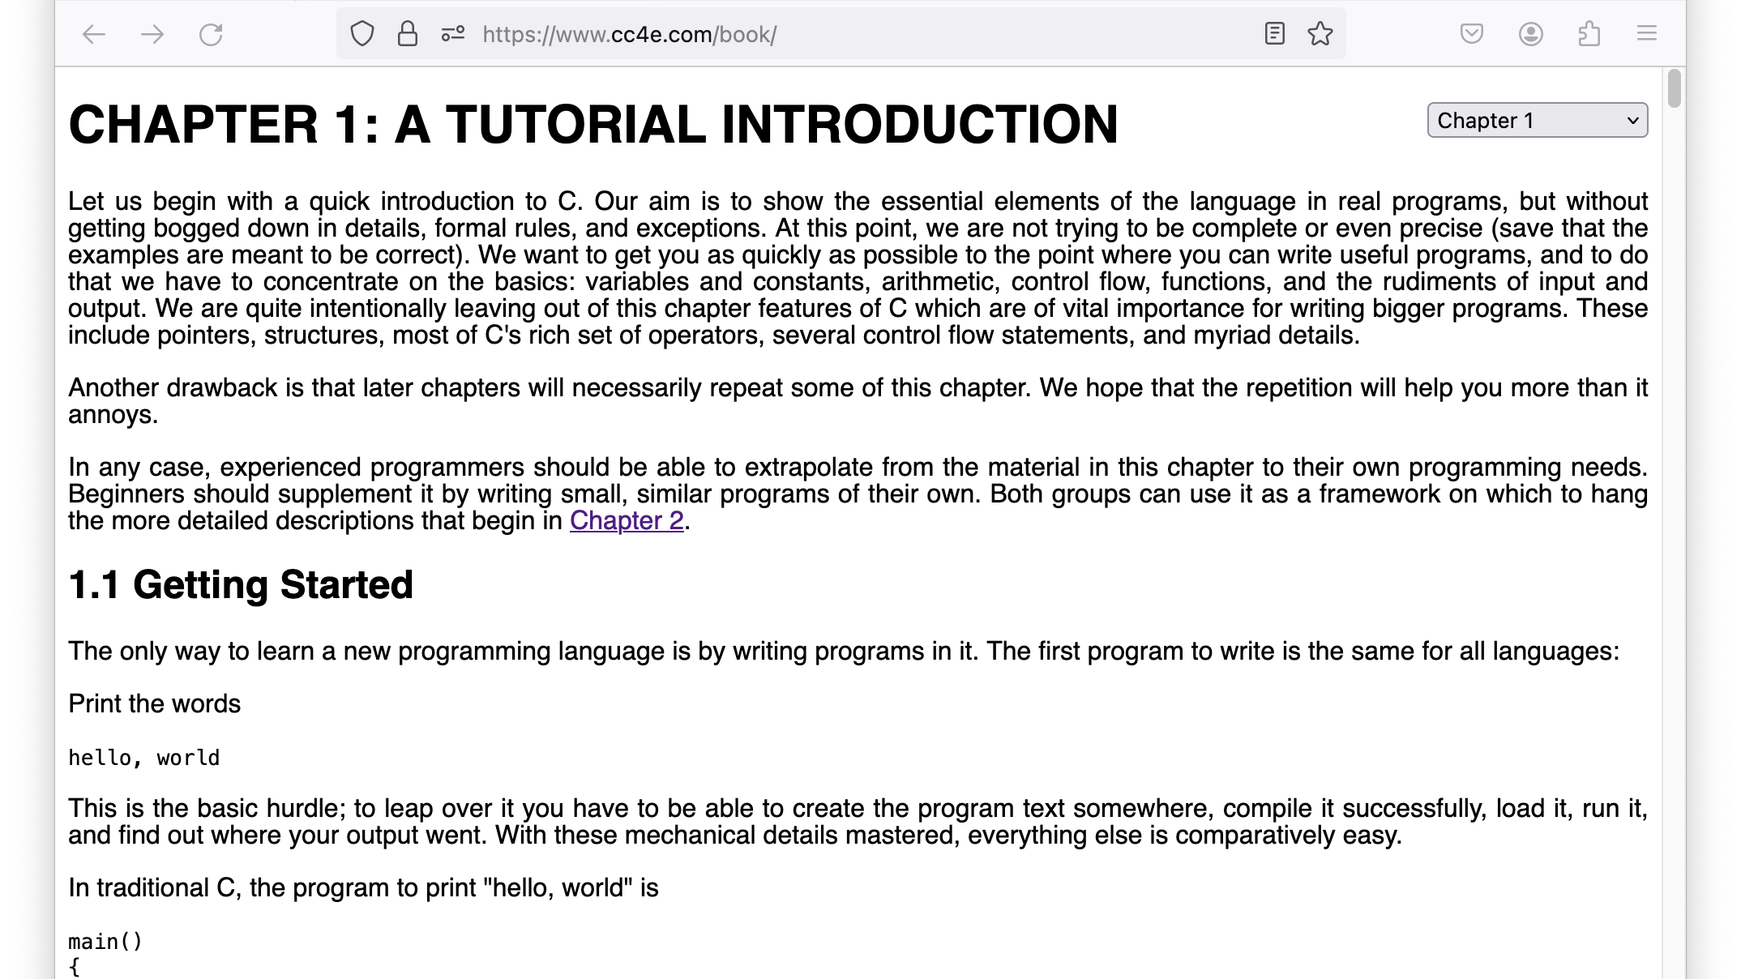

Slide 26
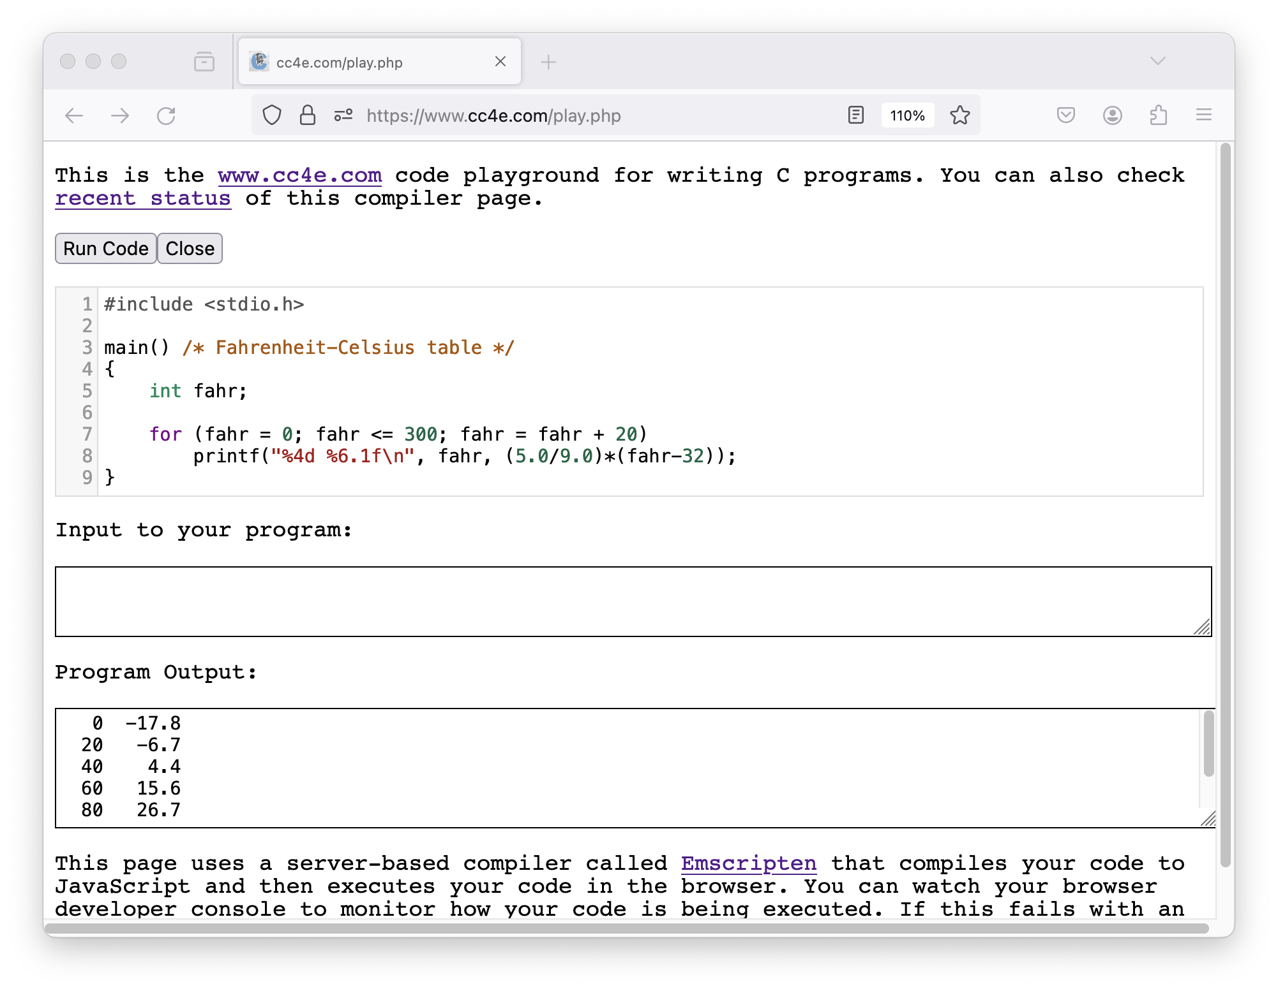

Slide 27
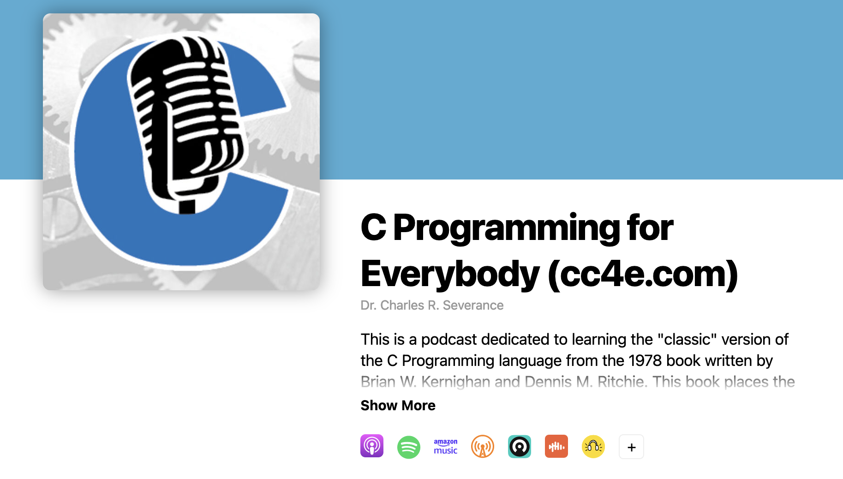
https://audio.cc4e.com

Slide 28
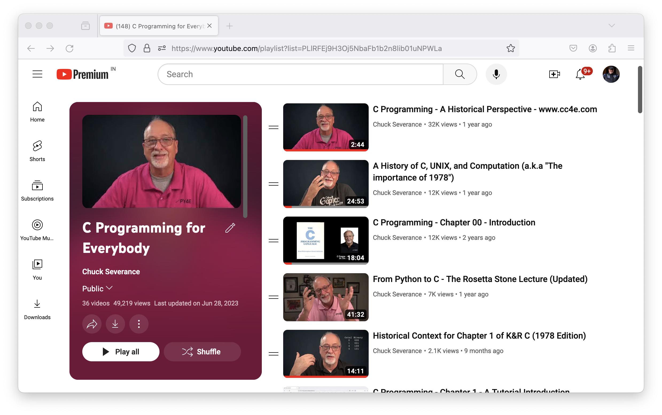
https://video.cc4e.com

Slide 29
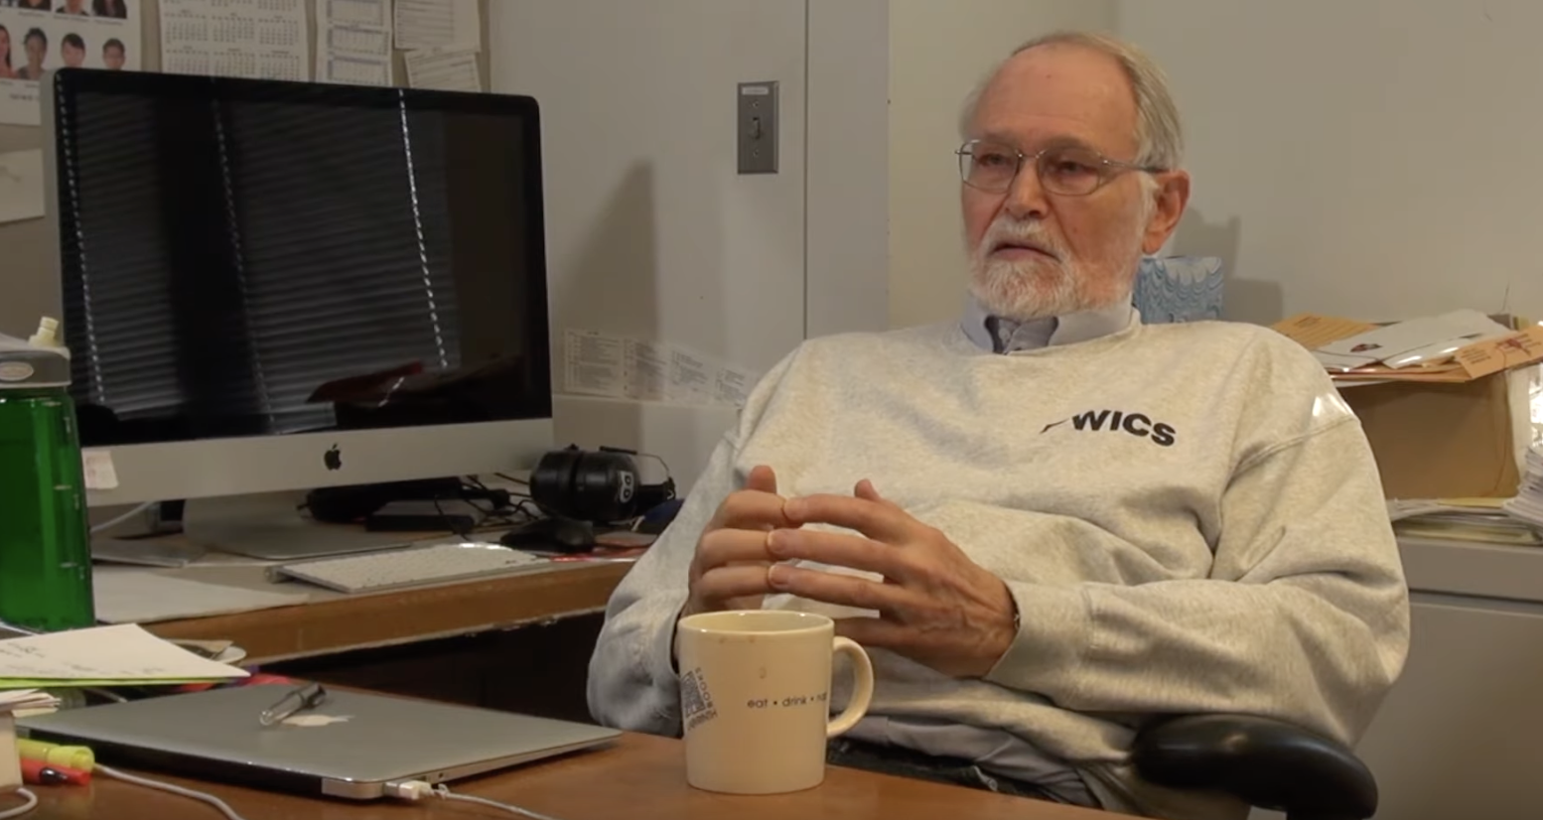
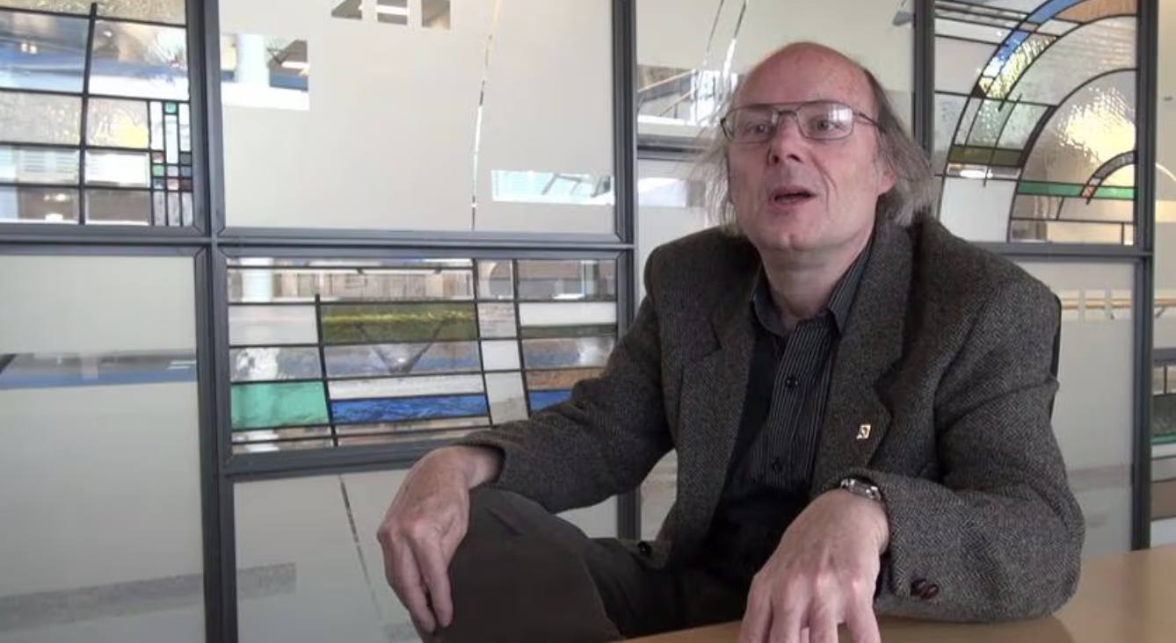
Brian
Kernighan
Bjarne
Stroustrup

Slide 30
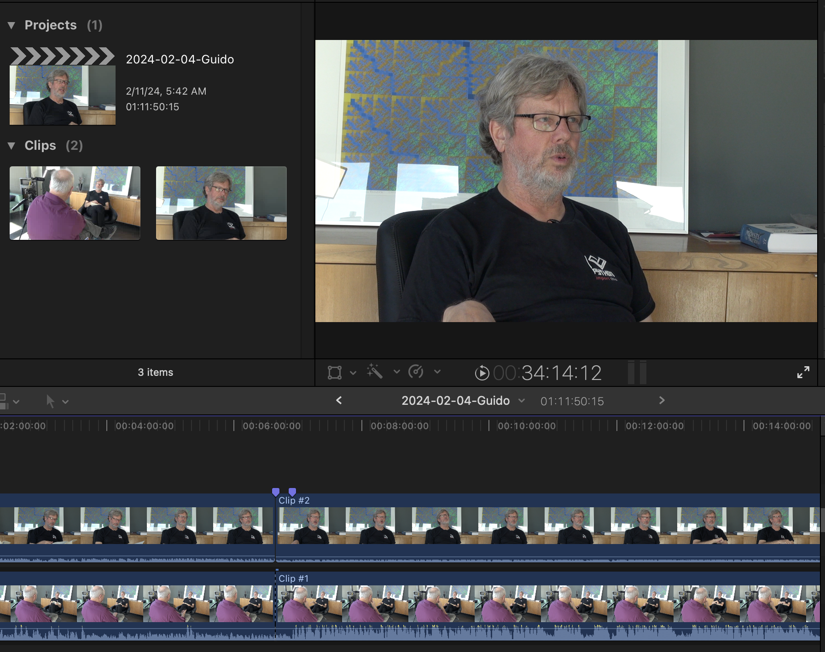

Slide 31
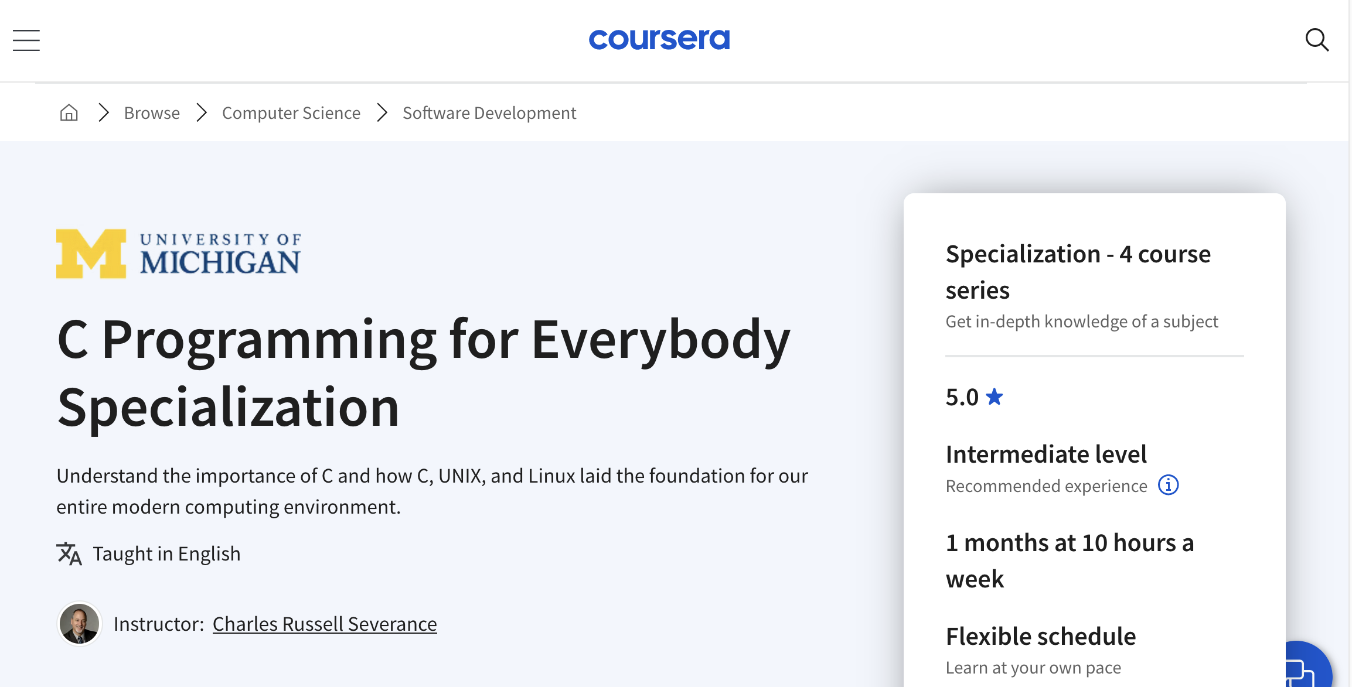

Slide 32

After C: Computer Architecture

Slide 33
My goals for students (not the course outline)
What is an "electronic computer"?
What is a gate?
What is inside of a chip?
How do CPUs work?
What is machine language?
What is an assembler?
What is a compiler?

Slide 34

Navigating the Path to Mastery
It is not about learning everything
It is about preparing to learn anything

